Slide 1
Semantic Segmentation with Deep Learning for Microstructural Characterization and Analysis
Prepared By: Ricardo Zambrano

Slide 2
Goal
The goal of the project was to train a model for microstructure segmentation, a common task in metallography
The system will expect a microscopy image with magnification from 50x to 1000x (can resolve features with size ≥ 0.2 micrometers)
The system should detect microstructural features in the microscopy image and return a segmentation mask as an output. This mask categorizes each pixel in an image into a class corresponding to the phase observed in the material

Slide 3
Deviations from Initial Goals
Initially the model for this project was meant to follow the model architecture implemented by Stuckner et al in the paper “Microstructure segmentation with deep learning encoders pre-trained on a large microscopy dataset”
The model architecture was not publicly available
Pretrained weights available to the public are ‘off-the-shelf’ technology
Training dataset proprietary (NASA) ➔ Aachen-Heerlen annotated steel microstructure dataset
Micronet Dataset: ~ 100,000 annotated images
Aachen-Heerlen annotated Dataset: ~ 2,000 annotated images

Slide 4
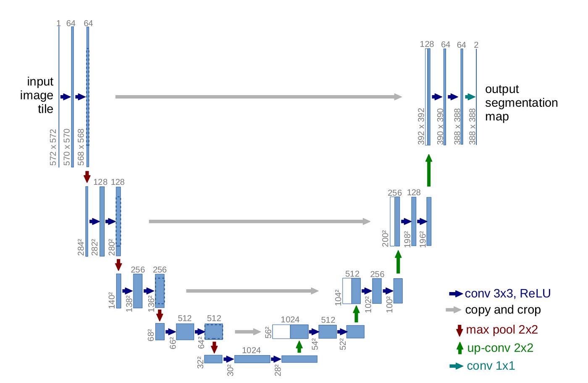
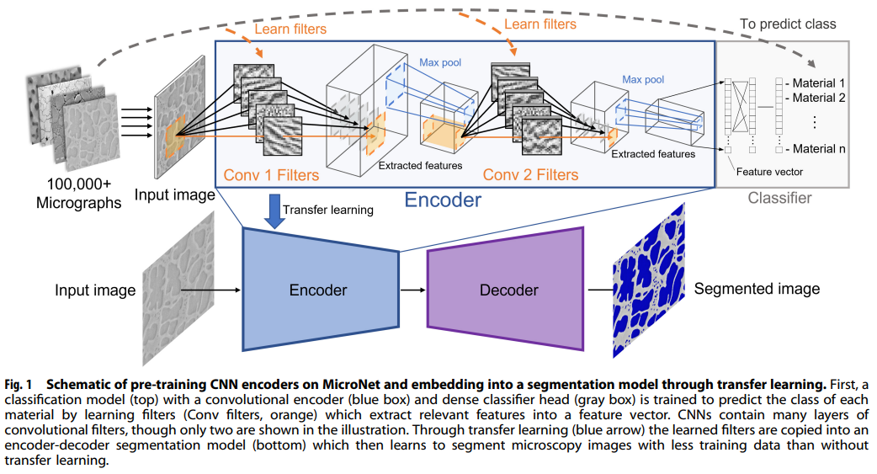
Deviations from Initial Goals
Encoder – Decoder -> CNN
Encoder – Decoder -> U-Net

Slide 5
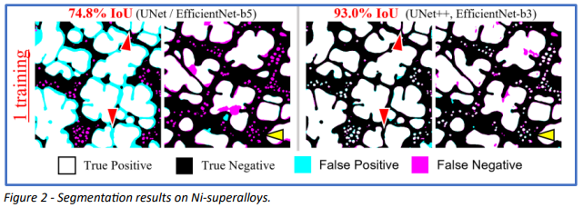
Methodology: Metrics Intersection over union accuracy (IoU)
True Positive (TP): The area of intersection between Ground Truth (GT) and segmentation mask(S)
False Positive (FP): The predicted area outside the Ground Truth
False Negative (FN): Number of pixels in the Ground Truth area that the model failed to predict
IoU = (TP)/(TP + FN + FP)

Slide 6
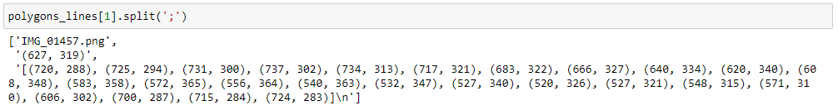
Methodology: Masks from Annotations
Reading annotated polygon
Each image would be listed more than one time in the .csv file.
An individual line represented one polygon in the image
Image Name
Polygon Center
Polygon Vertices

Slide 7
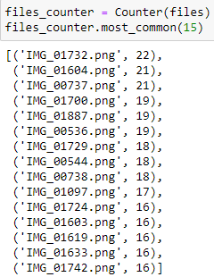
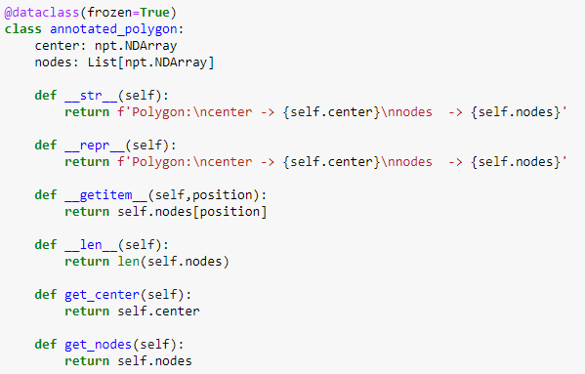
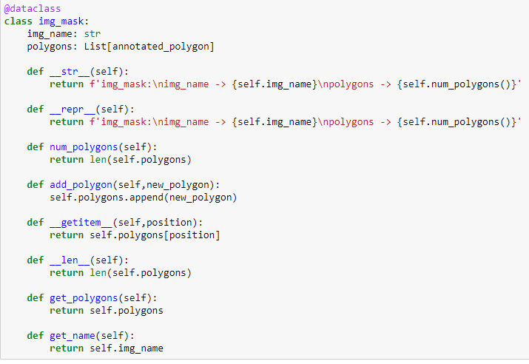
Methodology: Masks from Annotations
Used data classes to represent the polygons and the masks

Slide 8
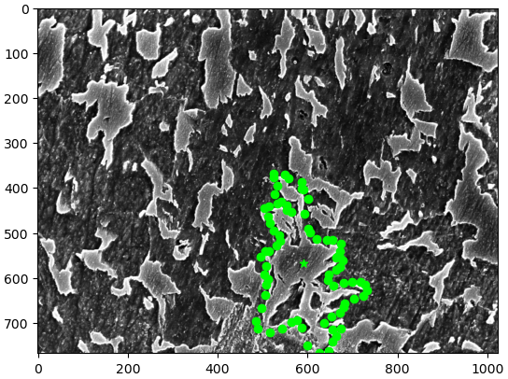
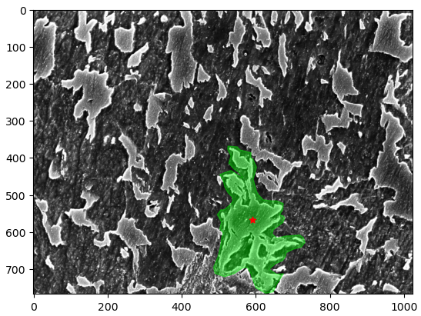
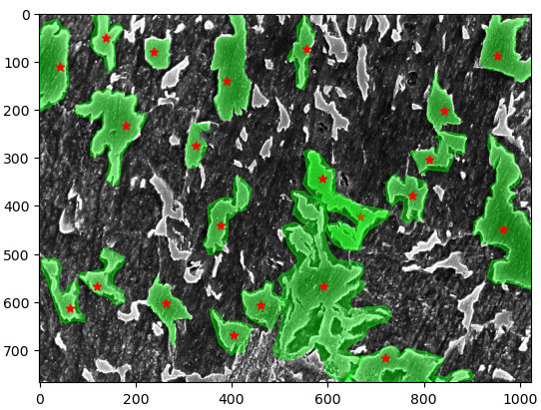
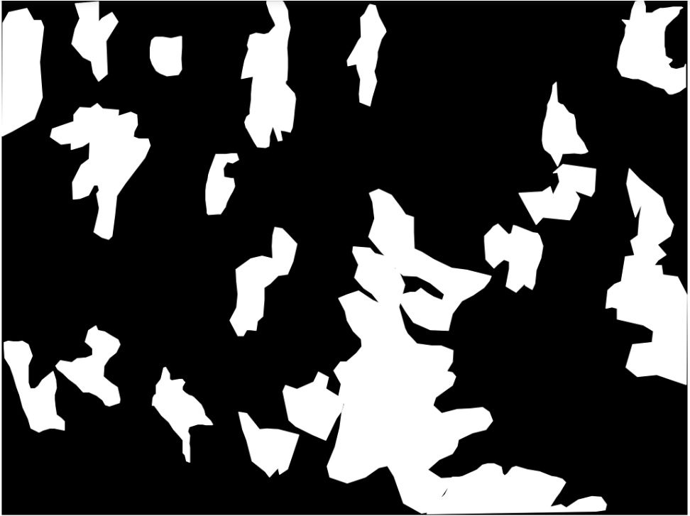
Methodology: Masks from Annotations

Slide 9
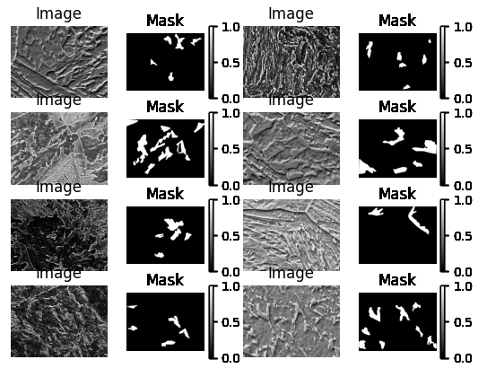
Methodology: Masks from Annotations
View of reconstructed dataset

Slide 10
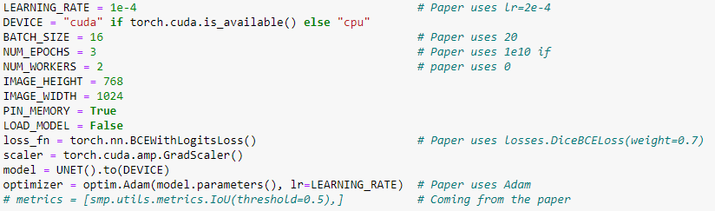
Model Training
Hyperparameters:
The model had to be trained in the cloud ➔ Yet, not all configurations were possible: RAM, GPU Memory
Notes:
Binary Cross Entropy with Logits Loss: https://towardsdatascience.com/understanding-binary-cross-entropy-log-loss-a-visual-explanation-a3ac6025181a

Slide 11
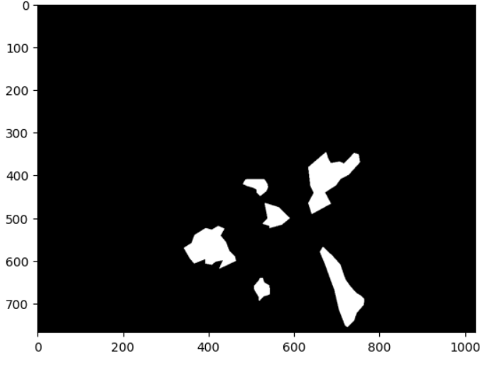
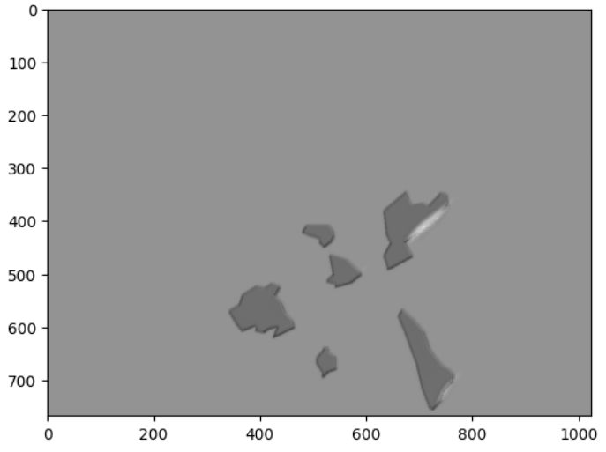
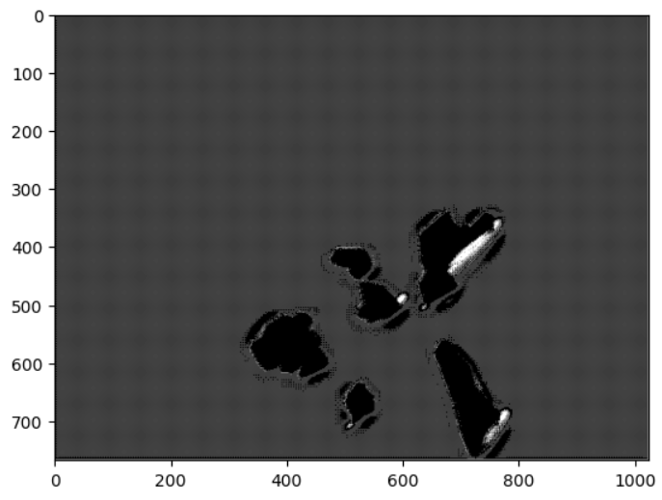
Model Training
Initial results (5 epochs – 100 training samples):
Idea ➔ Use thresholding > closing > opening in Raw Mask
Ground Truth Raw Mask Processed Mask
Notes:
100 -> 80 1300 -> 1040 mask_pred = torch.sigmoid(pred)
mask_pred = (mask_pred > 0.5).float()

Slide 12
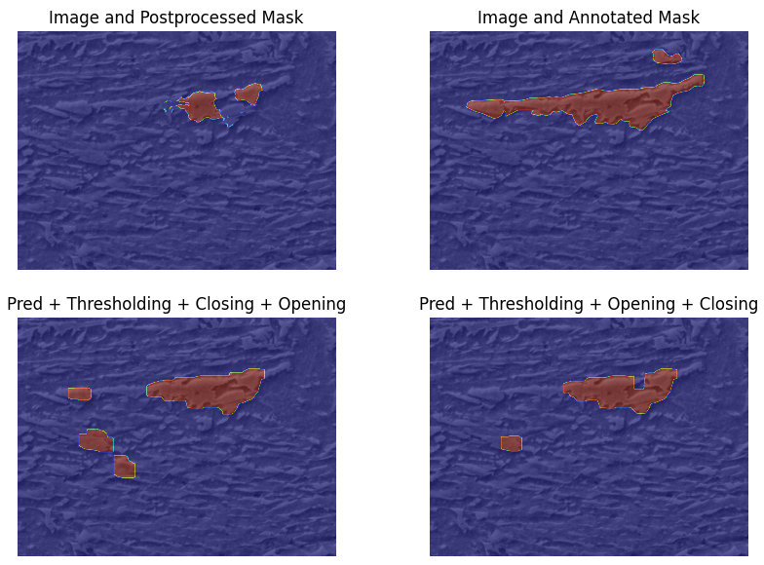
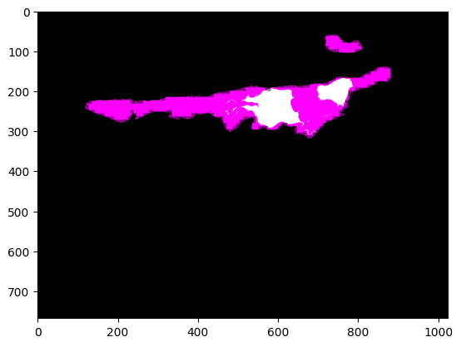
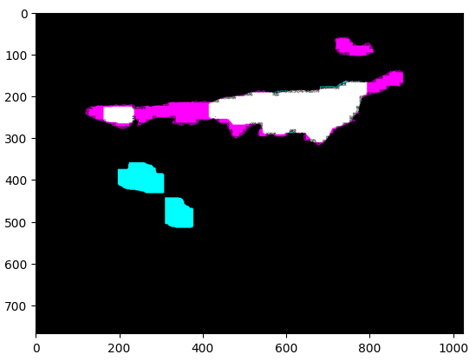
Model Training
Comparing image filters in Raw Mask
IoU
0.25
IoU
0.55

Slide 13
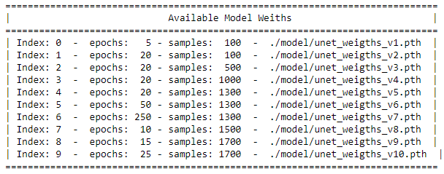
Model Training

Slide 14
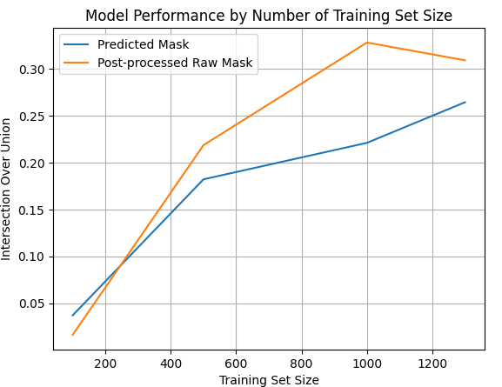
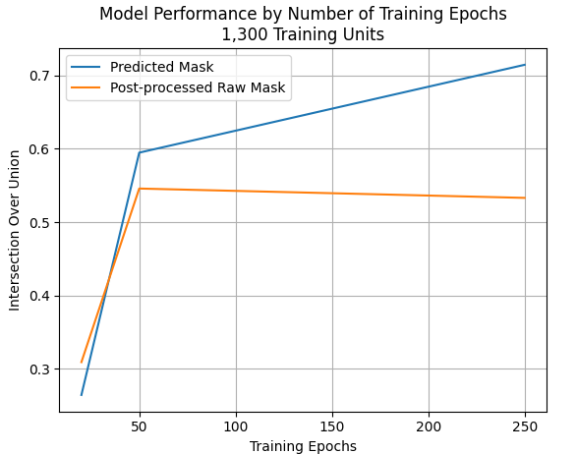
Results
Overall: predicted mask > filters on raw mask
Fixed to 20 training epochs

Slide 15
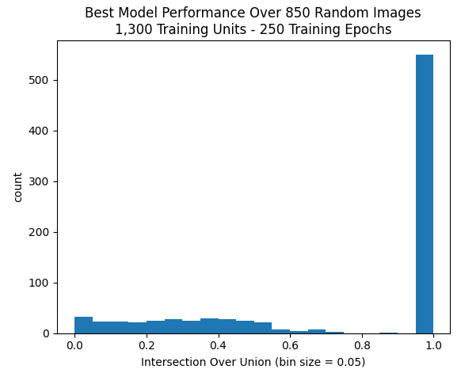
Results
On the best model more than 500/850 predicted masks had IoU > .95

Slide 16
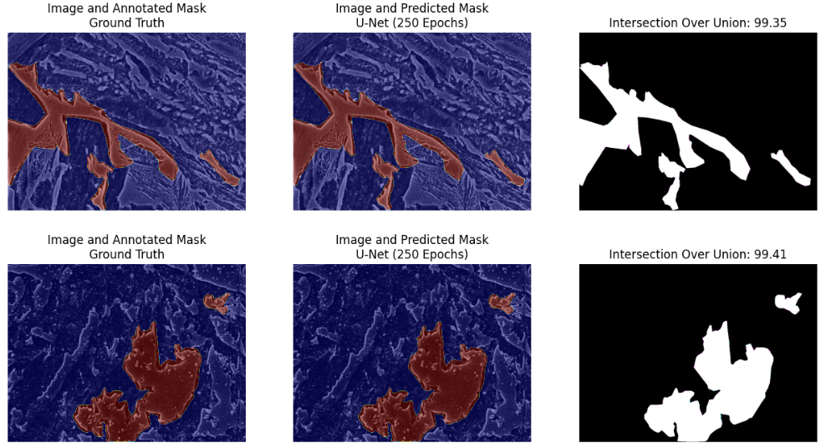
Results: Best Predictions

Slide 17
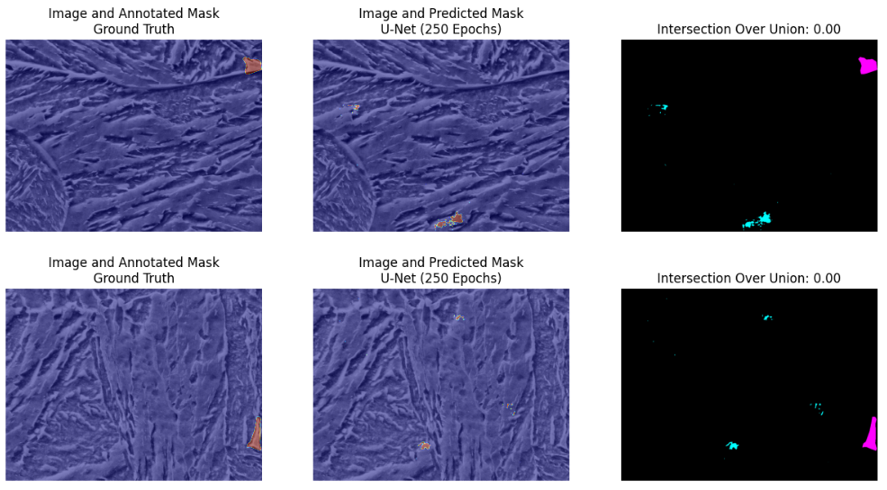
Results: Worst Predictions

Slide 18
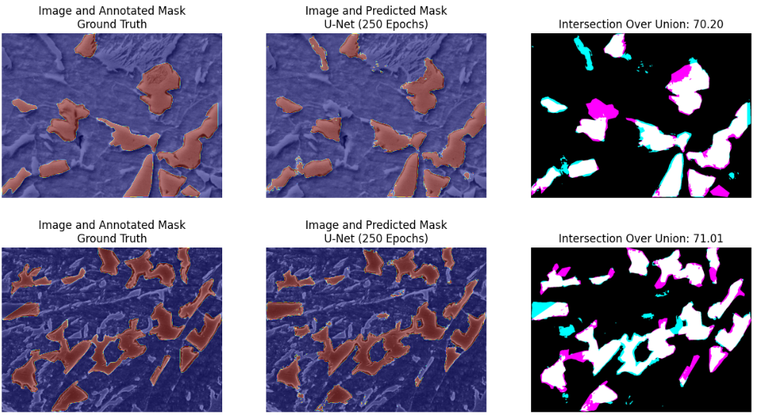
Results: ‘Subpar’ Predictions

Slide 19
Conclusions
U-Net is a neural network architecture effective for microstructure analysis
Cases with poor IoU performance seem to be poorly annotated – This conclusion needs to be verified by an expert
False positives occurred in regions of the image that look a lot like Martensite-austenite (MA) islands
IoU performance increases with training set size and training epochs
Using image filters for post-processing raw mask was not an effective technique in the aggregate
With a larger training dataset model testing can be more thorough

Slide 20
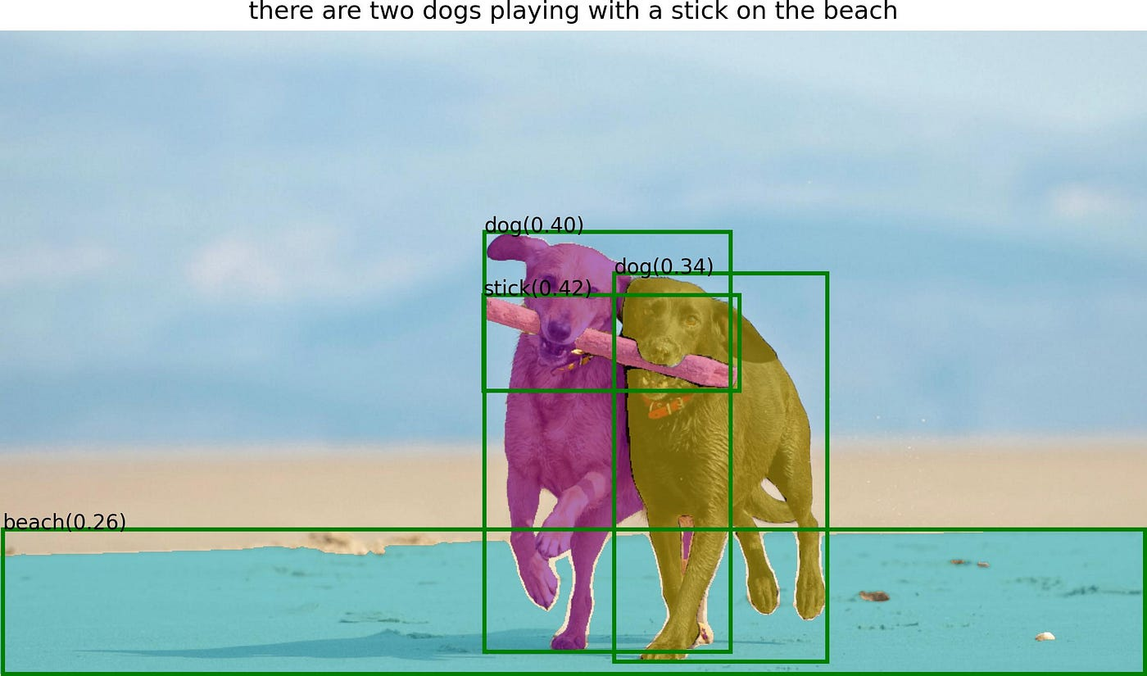
Thank You… Happy Summer!

